Slide 1
Forging a Functional Enterprise
How thinking functionally transforms line-of-business applications
Scott Havens
Director of Engineering
Jet.com and WalmartLabs
Notes:
Introduce me
Today I want to talk about the value you get from functional programming principles, and applying to whole systems, or even whole organizations.
I’m Scott Havens,
About Jet.com
Jet.com is an e-Commerce retail company headquartered in Hoboken, NJ. It launched publicly a bit over three years ago, with the plan to take on Amazon head-on. Roughly a year later, two years ago, Walmart acquired Jet.com. Jet now focuses more on the urban millennial customer while Walmart.com focuses on the mass market.
The two companies were built independently. However, ideally, we wouldn’t have different supply chains for Jet.com, Walmart.com, the Walmart stores, or any other part of the Walmart business. Unifying the supply chains has a lot of obvious benefits, but it’s not a small undertaking.
Director title, usually denotes a manager position.
My role is really more akin to an architect role, responsible for designing and building the unified supply chain systems for Walmart.
After the acquisition, for first few months, we had started early integrations, basic communication between existing systems
Not advanced full-fledged integration of systems or teams
Turns out, in an organization this big, surprise, there are a lot of politics

Slide 2
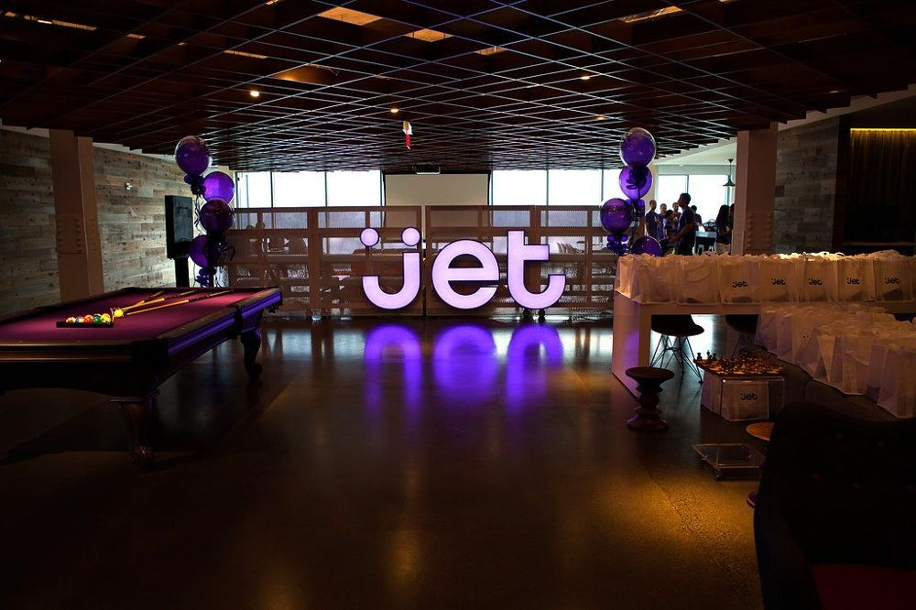
Notes:
One of the reasons Walmart had bought Jet is because the Jet tech stack looked transformative. It looked cool, almost but not quite as cool as our offices.
Not everyone convinced just by “cool”. They didn’t know if our techniques provided real world benefits.
Well, it wasn't long before we were fortunate enough to get the chance to demonstrate those benefits.
When I say we were fortunate, what I really mean is that disaster struck

Slide 3
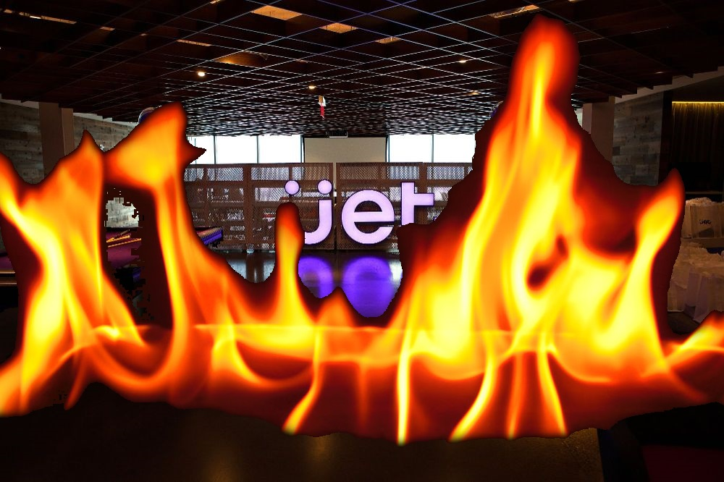
Notes:
Middle of march, last year, in the middle of the night, I got paged for some system alert.
Woke up, hopped on the bridge in case anyone else wanted to talk, and started looking into it.
Almost immediately joined by coworkers from several other teams
It turned out our production Kafka cluster was down.
If you’re not familiar with Kafka, it’s basically very scalable pub/sub messaging system
The primary method of communication among all our back end services
All at a dead stop
Before too long, we realized that it wasn't just down, but dead.
Every single message in flight in Kafka was gone. Customer orders, replenishment requests, catalog changes, inventory updates, warehouse replenishment notifications, pricing updates, every single one gone.
We were going to have to rebuild the cluster from the ground up.

Slide 4
???
Notes:
This could have been catastrophic. This could have been the end of the grand Jet experiment, enough to convince our new Walmart compatriots that Jet's technical tenets sound good on paper, but don't work in a real enterprise compared to tried-and-true systems. So, what happened?
I'm going to make you wait to hear the end.

Slide 5
What we’ll talk about
Functional principles
System design
Benefits (DevOps and more!)
Notes:
First, I want to talk about those Jet.com software tenets. Not just what Jet built, but why? Much of it is founded in principles of functional programming
Lessons learned from that can be scaled up, and influence system design in the large.
Then we’ll talk about the real world benefits to building and operating these systems.

Slide 6
Principles of functional programming
Immutability
Actions, not objects
Purity
Notes:
So, what are the principles of functional programming? There are many, but I’m going to focus on a handful today.
Immutability
Inputs don't change. Functions produce outputs that are also immutable. State is not directly mutated.
Actions over objects
Verbs, not nouns
Embrace Purity
We avoid writing functions that produce side effects. No writing to disk or network until the last possible moment, and we strictly control those side effects when we do. This makes it easier to reason about the code and test the code. The external world outside the function can't affect the results, and the function won't affect the external world. This makes the function very predictable and repeatable. Given an input, the output will be the same every time.
A benefit of is that functions become "referentially transparent" -- if you know the inputs in advance, or you've seen that input before, you can replace the entire possibly expensive computation with a precomputed cache of the result.
So now we’re thinking functionally. What does it mean to design functionally?

Slide 7
What is designing functionally?
Immutability =>
Message-based communication
Event sourcing
Notes:
Message-based communication. This is pretty ubiquitious. Systems communicate with each other via messages synchronously over HTTP or asynchronously over some kind of queue.
Event sourcing
Events don't change. Once an event occurs, it always will have occurred.
Events are first class citizens
Streams of events are the canonical data store.
State mutates, but current state is secondary.
In an event sourcing system, this state is usually in the form of some kind of snapshot. Snapshots of event streams are aggregate functions applied to the stream, a sum or a fold over all those events.
State is an interpretation of a stream events, and that interpretation can change. You may decide you want a new aggregate function to provide a different view of state. Maybe a median instead of a mean over the stream. If you choose to change how you define your state, you can reconstruct it at any time from the immutable events by applying the new aggregate function to the stream from the beginning.

Slide 8
What is designing functionally?
Immutability =>
Message-based communication
Event sourcing
Actions, not objects =>
Verbs, not nouns
Notes:
Verbs, not nouns
We don't build entity services. There isn't a monolithic CustomerAccount service like you might expect if you're coming from an object-oriented mindset. Instead, we identify workflows, things you're trying to do or accomplish, and build and name services with those verbs.

Slide 9
What is designing functionally?
Immutability =>
Message-based communication
Event sourcing
Actions, not objects =>
Verbs, not nouns
Purity =>
Compute and data are interchangeable
Notes:
In the same way it allows better testability and easier understanding of individual functions, purity allows you to plug together systems more easily.
Referential transparency becomes important here, because it permits large scale refactoring not just of systems, but of systems of systems. Maybe, during customer checkout of your e-commerce site, you call a transportation system that calculates time in transit from zip code A, the warehouse location, to zip code B, the customer, on the fly. This computation is pretty expensive. Advances in tech make it feasible to precompute every combination, turning an expensive computation into a cheap point lookup in a KV store. The inputs and outputs at the system boundaries haven't changed at all due to that referential transparency. You've just turned the computation into data. And now maybe that lookup is cheap enough to use this data on every product page view instead of just at checkout, improving the customer experience.
Now, let's dig into a real world system at Jet that was designed following these principles. Most Jet systems are named after superheroes.. Two years ago, we were planning a new system, but a lot of names were taken. I tried to think of a superhero who wasn't yet popular enough to be chosen but who might have some clout down the line. So, ladies and gentlemen, for today's case study, allow me to introduce:

Slide 10

Introducing “Panther”
Notes:
Couldn't get the rights from Marvel for any officially licensed media but I like this picture better anyway.
Inventory tracking and reservation management system
On the supply side, it aggregates and tracks all sources of inventory
Jet and Walmart owned warehouses
All partner merchant warehouses
On the demand side, it acts as the source of truth for reservations against available inventory at those warehouses. When a customer is checking out, the contents of their cart are reserved. If the inventory is not available at that point, the reservation fails and either the items must be resourced or different items must be selected.
Between the two, our primary goals are to
Maximize on-site availability, while
Minimizing reject rates due to lack of inventory
Our secondary goals were to
improve the customer experience by reserving inventory earlier in the order pipeline
Enhance insights for the marketing and operations teams by providing more historical data and better analytics
Unify inventory management responsibilities typically spread across multiple systems.
Of course, along with these business goals, our solution had lots of nonfunctional goals, like
High availability
Georeplication
Fast performance backed up by SLAs.
Let’s jump into how we built Panther and how it solves these problems

Slide 11
Core flow – executing commands
Notes:
Basic building block of systems at jet, a fundamental pattern that can be used for every domain. At a high level:
A stream of commands
Executed against aggregates
Produce events
Stored in streams
Let’s walk through all of these step by step, starting with executing a command.

Slide 12
Core flow – executing commands, producing events
Ingest message
Deserialize strongly typed command
Retrieve current state from database
Execute command
Commit output event
Notes:
This has five steps.
Ingest message
Could be from Kafka, HTTP, queue
Could be JSON, Protobuf, Avro
Deserialize message to strongly-typed command in our language of choice.

Slide 13
Commands
UpdateInventory
ReserveInventory
CancelReservation
ShipOrder
ArchiveItem
Notes:
Commands are messages that express intent to change state
Named with imperative verbs and usually a direct object, e.g.
UpdateInventory
ReserveInventory
ExpireReservation
ArchiveItem

Slide 14
Strongly typed commands
type ReserveInventory
{
id : CommandId
orderId : OrderId
skuId : SkuId
fulfillmentNodeId : FulfillmentNodeId
quantity: Quantity
by : Username
at : DateTimeOffset
}
Notes:
Name of the command indicating intent
A field or fields identifying the relevant aggregate
Any additional content for the command, in this case the quantity to reserve
Some metadata, like who triggered the command and when

Slide 15
Core flow – executing commands, producing events
Ingest message
Deserialize strongly typed command
Retrieve current state from database
Execute command
Commit output event
Notes:
Using the identifier from the command, retrieve the current state from the datastore
There are a few different ways of constructing the state in the first place, which I'll touch on later, but for now just assume that state, or if you're using Domain-Driven Design language, that aggregate, exists somewhere.
For inventory commands, the appropriate identifier is usually the SKU ID + FN ID.
Retrieves, say, the current inventory counts for that SKU at that FN
Also, and this will be important in a moment, it retrieves a logical clock for that state -- a monotonically increasing integer -- that identifies the last update. That clock is called the sequence number. If there have been a million changes to this inventory, the sequence number will be 1,000,000
With a command describing intent, and the current state you want to change, you execute the command against the state.
Executing the command does not itself change the state
Command execution is a pure function. It does not induce a side effect.
It executes business logic usually consisting of validation rules
In some cases, the command comes straight from the source of truth so there's not much to validate. For instance, with UpdateInventory, the command is straight from the merchant or warehouse. They're the source of truth for their own inventory counts, so validation we perform is trivial.
ReserveInventory is an example of a command with real validation, but still simple. Is the quantity being reserved less than or equal to the quantity available to sell? Great. If not, it failed.
So if executing the command doesn't itself change the state, what does it do?
It emits an event as output.

Slide 16
Events represent the changed state
Command
Event
ReserveInventory
InventoryReserved
Notes:
An event indicates something that has happened
It usually flips the syntax of the command that triggered it, with a past tense of the verb.
InventoryUpdated
InventoryReserved
ReservationExpired
Validation failures are events, too, with the format CommandNameFailed
ReserveInventoryFailed

Slide 17
Core flow – executing commands, producing events
Ingest message
Deserialize strongly typed command
Retrieve current state from database
Execute command
Commit output event
Notes:
With output event in hand, you commit the event to the event stream
Everything up to this point has been done entirely in memory, nothing has been saved
It's only provisional until it's committed
Attempt to write the new event to the stream at the next expected sequence number
If the write is successful, with no conflicts, then the event has officially happened
If the write attempt fails due to a conflicting write -- another writer already wrote an event with that sequence number -- then this provisional event is invalidated.
We must re-retrieve the changed state and re-execute the original command against that new state
Should be noted that this model of executing commands, or really just processing a stream, lends itself extremely well to a functional style of coding
Start with your immutable inputs
Command
Current state
Run a chain of stateless functions
Write an immutable output
So now we have an event stream. You can't just look at the latest event and know what the state is, though. A ReserveInventory event won't tell you how many items are still available to sell. How do we build current state?

Slide 18
Core flow – building state from events
How do we build state from events?
“Zero” state
Apply function
apply(original stateold, event) -> new state
Fold function
foldEvents(apply, original state, events[]) -> new state
Notes:
Again, while you can do this in pretty much any language, this is extremely well suited for a functional style. Define:
Initial (“zero”) state. Pretty easy, an unknown SKU at an unknown FN with 0 onhand.
Apply function that takes a state and a single arbitrary event as parameters and produces a new state as output
This is where the meat of the business logic usually is, and that's the case here
We know every single event that the system can possibly produce, so will write business logic to handle each case.
After InventoryUpdated, the onhand will be reset to whatever the merchant told us in the event, and the count of completed (e.g. shipped) reservations we were keeping around for accounting purposes can be reset to 0.
After InventoryReserved, onhand will stay the same, total reserved will increase by X, and ATS will decrement by X.
A fold function that takes the apply function we just defined, a state, and a sequence of events to apply.
These three things are used by the SnapshotEventStream service to build the current state.

Slide 19
SnapshotEventStream
Receive batch of events for stream
Get latest snapshot for stream
Apply sequence of events to snapshot
Include the sequence number in the snapshot!
Save up-to-date snapshot
Notes:
It reads in a batch of just-committed events from the stream, retrieves the latest snapshot from the snapshot datastore, applies the entire batch of events, and overwrites the old snapshot with the newly updated one.

Slide 20
Panther architecture
Notes:
Now that we understand the fundamental command execution and event sourcing pattern, let’s zoom out to the whole Panther system.
What we see is that core flow in the middle, with
Synchronous vs asynchronous inputs
Filtering and mapping for downstream
Let's talk storage.

Slide 21
Storage requirements
Event stream storage
Optimistic concurrency
Low latency writes
Snapshot storage
Change Data Capture (CDC)
Notes:
Storage for a system following this pattern has some specific requirements that I’ve divided into three areas.
Event stream storage
It needs Optimistic concurrency on event writes, In many, if not most, circumstances, If two command executors are trying to write an event 1000 in a single stream concurrently, one should fail. The validity of the second event may be affected by the first. Thus, instead of blindly writing the second event, the second executor should throw out the second event, re-retrieve current state, and try again. This ensures that event streams are strictly serialized.
Because stream processing is strictly serialized, write latencies for events are extremely important. Your maximum throughput per stream is going be determined by this write latency. If a write of an event takes 100ms, you can only process 10 commands/second.
This is a tricky requirement when you also want your storage georeplicated – there’s a tradeoff between consistency and latency
Snapshot storage
You'll want low latency high throughput reads and writes of individual documents representing a snapshot, or aggregate, of a stream.
You may want these to be queryable as well, but for the most part these will be point lookups.
Change data capture
[Talk about DUAL WRITES HERE]
Every single event, once committed, needs to be published for downstream consumers. Most obviously, this allows the snapshot service to run asynchronously, but in practice there is huge business value in being able to notify arbitrary downstream consumers of changes in your system.
Change data capture doesn't just apply to events. Some downstream consumers may not care about how you got to the current state, just what the state is. On an e-commerce site, the customer doesn't need to know every single Playstation 4 purchase that ever happened. They just need to know: is the Playstation in stock or not? So it's helpful to be able to publish all snapshots every time they change as well.

Slide 22

Azure Cosmos DB
Event streams!
Snapshots!
Change Feed!
But wait, there’s more!
Notes:
We've chosen Azure Cosmos DB. It handles all these requirements brilliantly. I could easily do a whole talk comparing and contrasting different databases, like Cassandra, in light of these requirements, so find me later if you want to talk more about this.

Slide 23
Benefits

Slide 24

Resiliency
Notes:
What is resiliency
System stays functional with little or no customer impact in case of partial outage
Recovery from outages is trivial
Errors are trivially corrected or self-correcting
What kind of errors or problems might we see, and what can this handle?

Slide 25
Resiliency
Bugs in our code

Slide 26
Resiliency
Bugs in our code
Out of order messages
Notes:
Out-of-order reservation workflow events
Sources
Front end systems
Order management systems
Warehouses
3P
How we deal
Learnings from conflict-free replicated data types (CRDTs) and other lattice-based data structures
We treat our events:
Idempotent
Commutative
One way to do this is to make state (inventory snapshots, reservations) additive only
Literally add more data to the state
state changes are monotonic -- a reservation, once shipped, can never return to the created stage. An event’s sequence number, once applied, won’t regress.

Slide 27
Resiliency
Bugs in our code
Out of order messages
Downstream consumers lose data
Notes:
Downstream consumers (e.g. inventory caches)
Causes
Bugs
Data loss
Replay
From Kafka
From datastore changefeed

Slide 28
Resiliency
Bugs in our code
Out of order messages
Downstream consumers lose data
Random restarts
Notes:
Happens in prod naturally
Chaos testing
All our microservices, being functions, are stateless. If they are restarted, they’ll immediately just pick up from the last unprocessed message.

Slide 29
Resiliency
Bugs in our code
Out of order messages
Downstream consumers lose data
Random restarts
Regional outage
Notes:
Running hot-hot where applicable (particularly Tier 1)
Can switch write region for datastore in seconds
Or run multimaster
Can scale up secondary region in seconds

Slide 30
Easy to add features
Notes:
With inventory tracking, staleness of data is an issue. Simply put, if a merchant last told us their inventory months ago, there is no way we can trust it. So, we wanted to implement a feature that expires merchant inventory updates after a certain amount of time. Just zeroes it out.
Results were immediate – we dropped our third party reject rate in half from 0.8 to 0.4%
What’s great is: this was done by single engineer, new to the company, with light F# training and no cloud microservice background, from design to production, in three weeks.
Single engineer in July 2016, only 3 delivered by Holiday 2016. Only 5 engineers by end of first year.

Slide 31
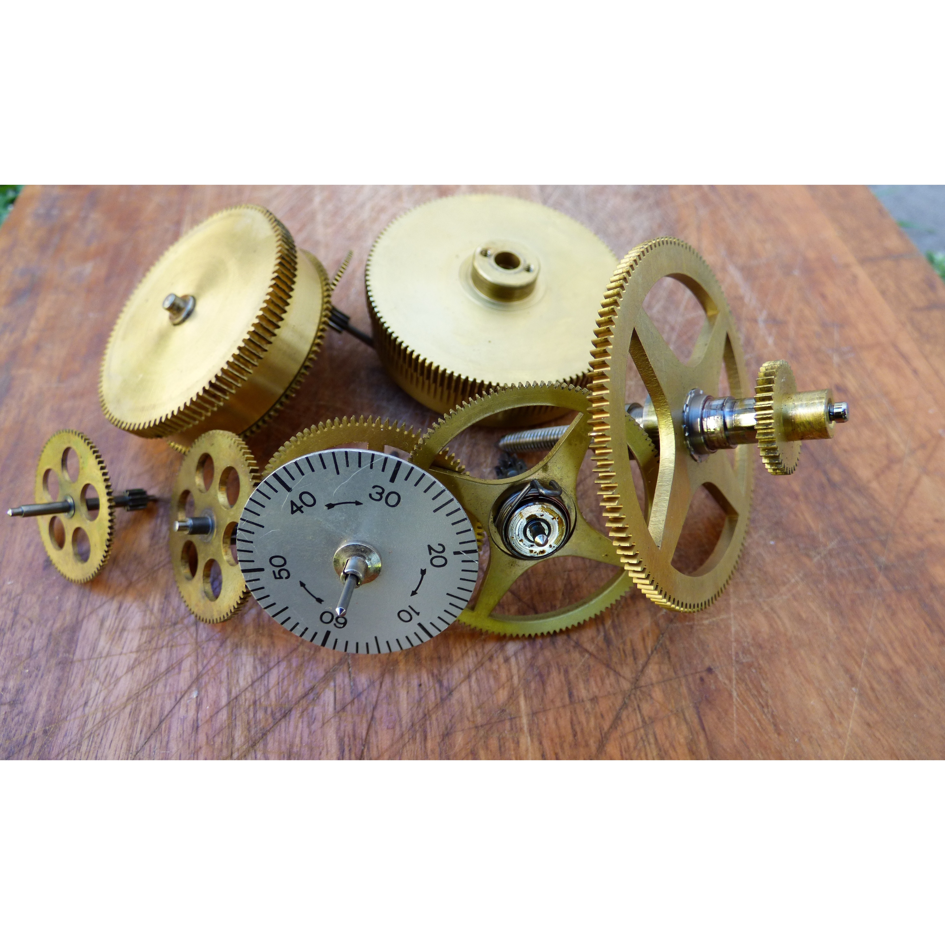
Time machine
Notes:
Can see the state for any point in time
Walk step-by-step through everything that happened
Troubleshooting
Validate behaviors that people are observing -- people report a problem around a specific time,
days, weeks, months later
we can go back in time and reobserve it and RCA.
Auditing
Analytics

Slide 32
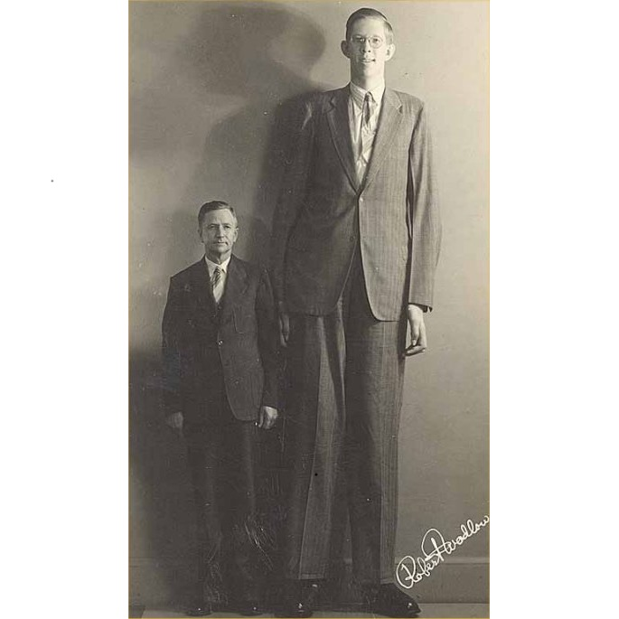
Scaling
Notes:
Scaling, in practice, happens along two dimensions:
Compute
Storage
Compute -- our microservices are:
Deployed & scheduled on Nomad or Kubernetes clusters
Independently deployable
Independently scalable
Datastore
Scale the throughput within seconds to 10 or 20x normal
Partitions will automatically split if they get too full
We’ve had to use this in practice.
Overnight went to 250% of normal throughput
When that's done we can scale back in seconds

Slide 33
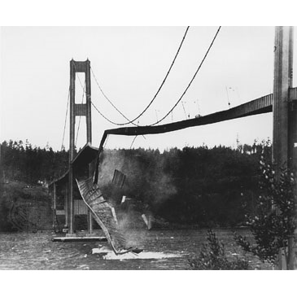
Testability
Notes:
100% of domain logic is unit-testable
The function that executes commands and produces events has no external dependencies and has no side effects
The function that applies events to state to produce new state has no external dependencies and has no side effects
These are pure functions
Can provably identify every single path through the business code and unit test them.
Not just write unit tests, but create executable specifications. Define invariants from your specification explicitly as properties. For example, you could say that inventory counts should never be negative. These properties will be checked with large numbers of randomized inputs extremely quickly. As we write primarily in F#, we use FSCheck, but similar spec-based or property-based testing frameworks are available for lots of other languages.

Slide 34
Notes:
So, now we’ve covered
functional principles
designs of systems built on these principles
benefits conferred on those systems
How
Rebuilt cluster -- new brokers deployed in minutes. While this was happening, we coordinated with all teams who manages edge systems
systems exposed to the outside world
merchant API inputs
Customer order inputs
These edge systems, like all the others, are event sourced. The teams reset checkpoints on their event streams to a point in time just prior to the outage
All the events after that point were re-emitted to downstream consumers
When those checkpoints were set back, there was overlap on messages that had already been sent and processed downstream.
The downstream systems all were designed, and had been fully tested, to handle duplicates and act idempotently even though they’re out of order.
These downstream systems hit by a flood of messages, but we just scaled them out in seconds, some manually, some automatically, to handle the throughput and stay within SLAs.
In the end, this potentially catastrophic event was little more than a minor annoyance. No data was lost and not a single customer order was delayed.

Slide 35
Recommended reading
Designing Data-Intensive Applications
The Big Ideas Behind Reliable, Scalable, and Maintainable Systems
by Martin Kleppmann
Domain Modeling Made Functional
Tackle Software Complexity with Domain-Driven Design and F#
by Scott Wlaschin

